Slide 1
Eliminating Plastics
By Lisa Burbank

Slide 2
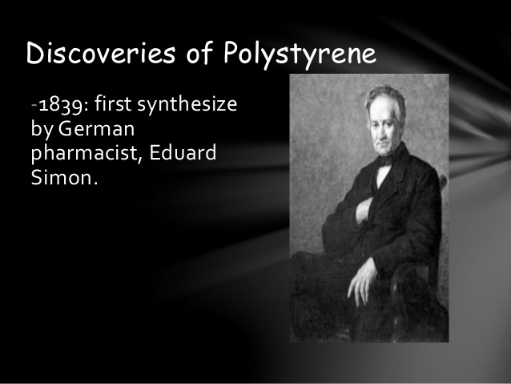
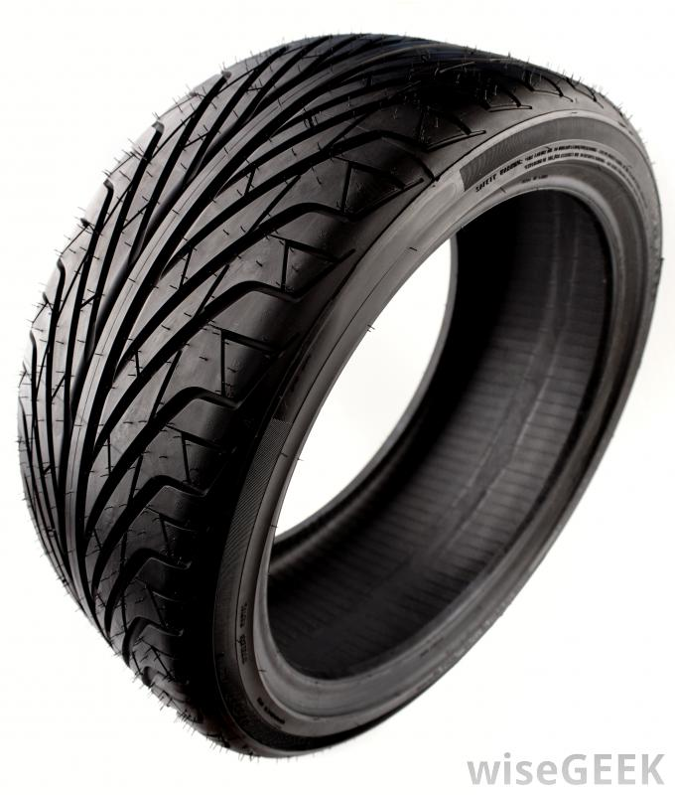
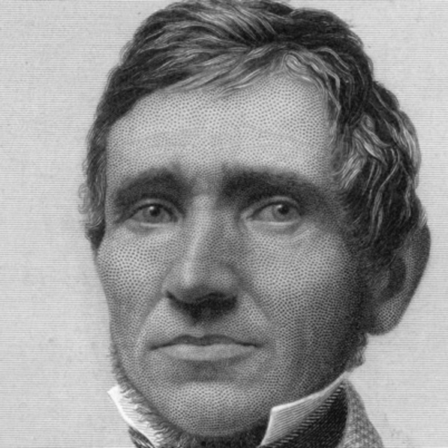
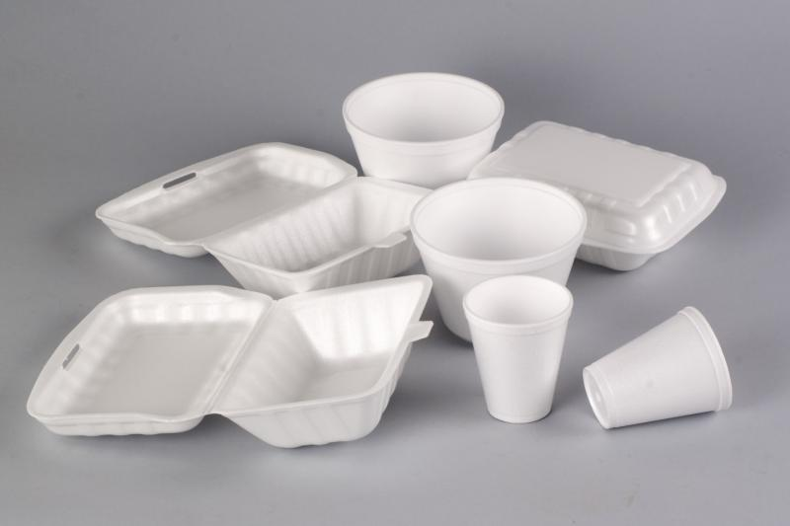
A History of Plastics
1839
Charles Goodyear invents vulcanized rubber:
Tires
Garden hoses
Bowling balls
Hockey pucks
Instrument mouthpieces
Erasers
Shoe soles
German Apothecary, Eduard Simon,
discovers polystyrene:
CD & DVD cases
Smoke detector housings
Disposable cutlery
Single-use food containers & dinnerware
License plate frames
Produce trays/packaging

Slide 3
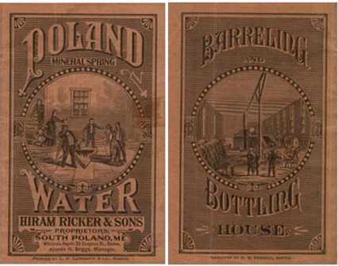
1845
Poland Spring, Maine:
Local spa becomes first to market bottled water…in glass jars, not plastic
Others quickly follow suit…

Slide 4
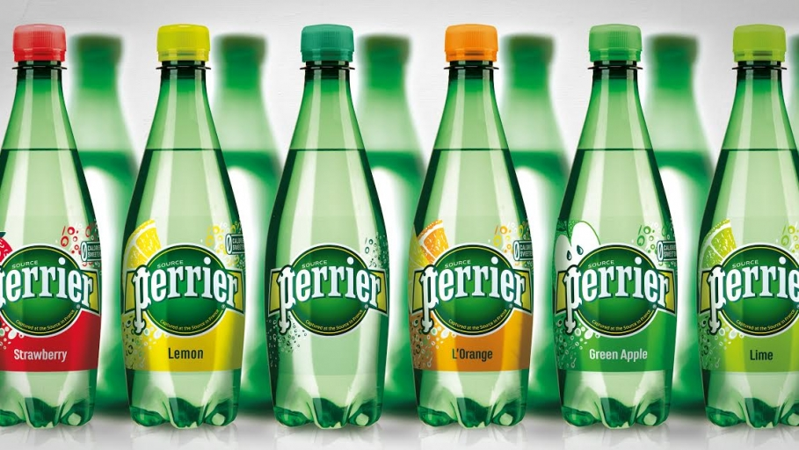
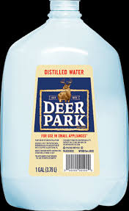
1873
Perrier company founded in France by Napoleon III.
Deer Park markets to “wealthy residents in Washington, DC…including President Taft, who honeymooned there and ‘took the waters’”.
1863

Slide 5
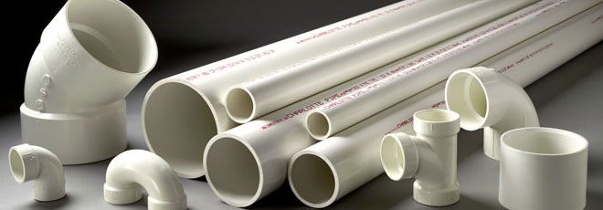
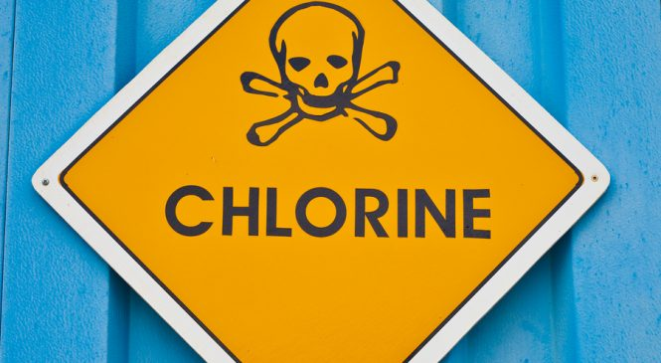
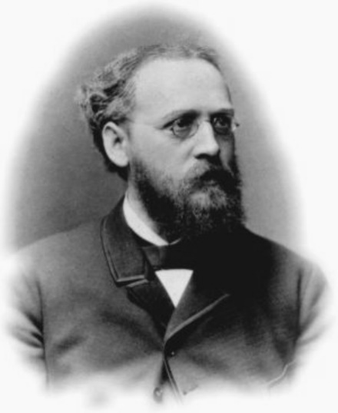

1872
Eugen Baumann introduces polyvinyl chloride, otherwise known as PVC:
Window shutters
Furniture
Water pipes
Considered unsafe due to chlorine content.

Slide 6
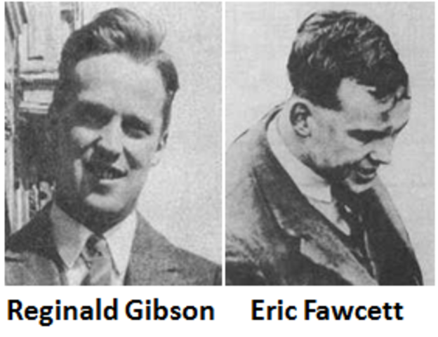
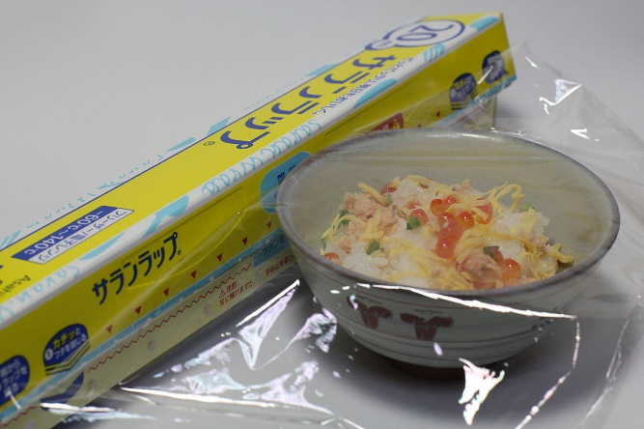
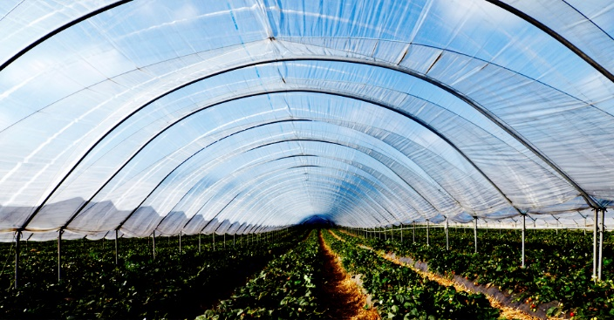
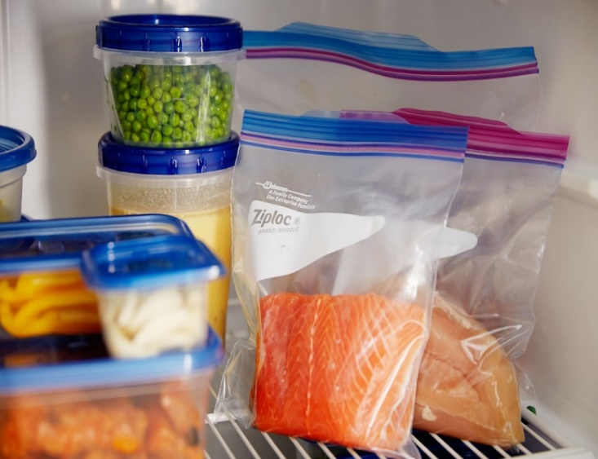
British chemists, Reginald Gibson and Eric Fawcett, create polyethylene:
Cling wrap
Freezer bags
Sandwich bags
Poly tunnels used in agriculture
1933

Slide 7
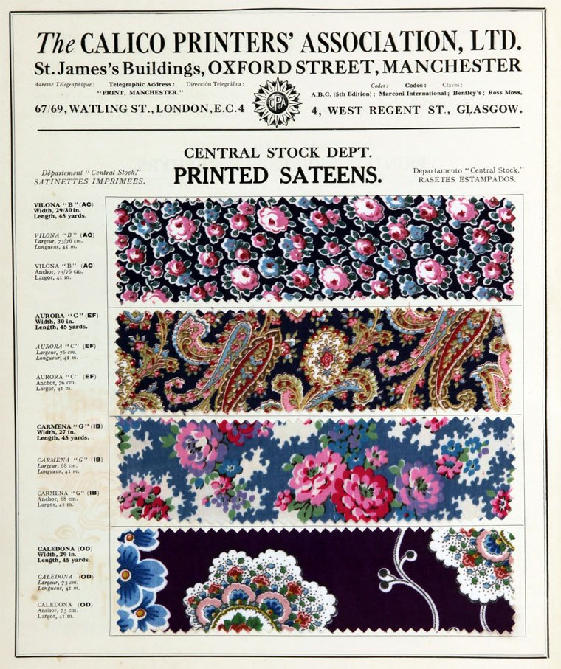

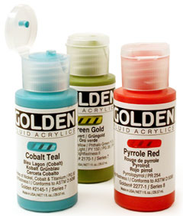
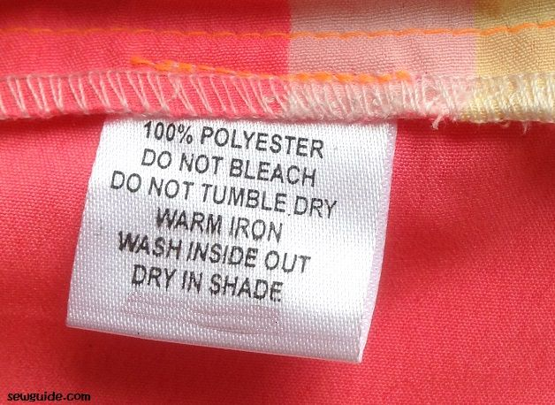
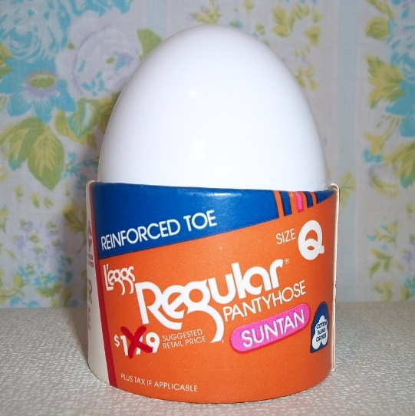
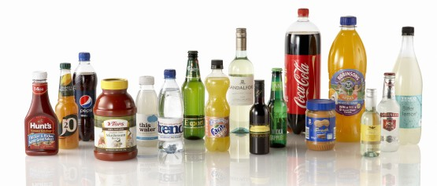
Employees of The Calico Printers’ Association discover Polyethylene Terephthalate:
Nylon
Acrylics
Polyester
Plastic bottles
1941

Slide 8
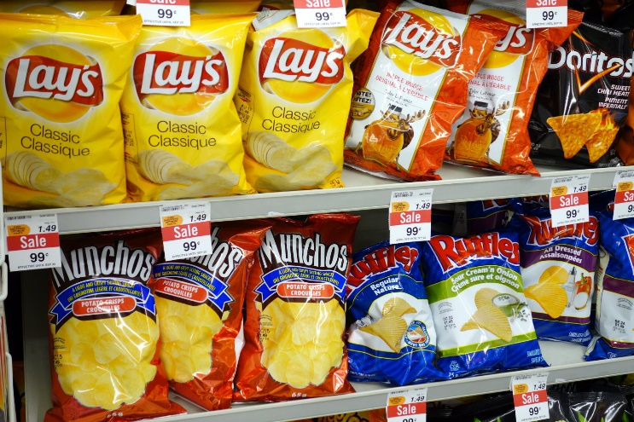

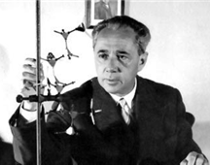
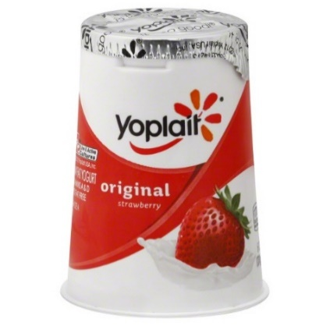
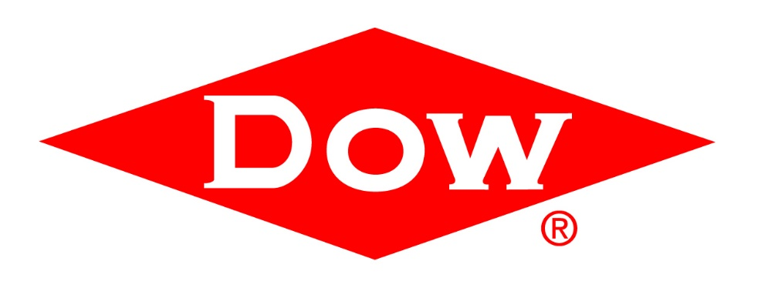
The Dow Chemical Company develops an expanded version of polystyrene:
Washing machines
TV’s
Other Electronics
1954
And Guilio Natta invents polypropylene:
Potato chip bags
Margarine containers
Yogurt containers

Slide 9
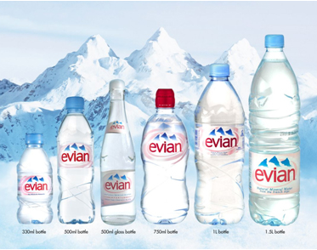
1984
Plastics and bottled water merge and are marketed as a unit for the first time by Evian…(Lapham, 2009; Andrady & Neal, 2009; Brand, 2012; Xanthos & Walker, 2017; Brodhagen et al, 2017; Miller et al, 2017).

Slide 10
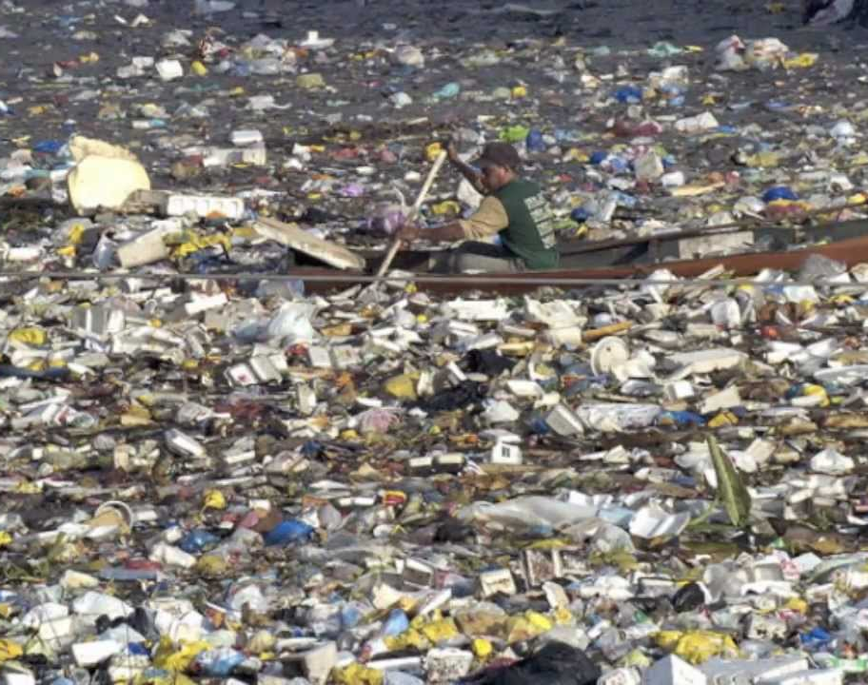
It is doubtful that any of these inventors, chemists, or discoverers intended that their products should result in this…
The Great Pacific Garbage Patch
2017

Slide 11
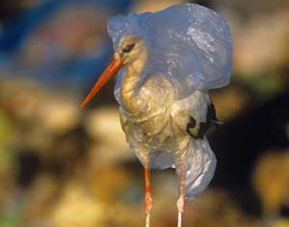
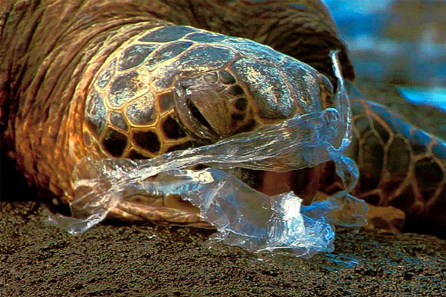
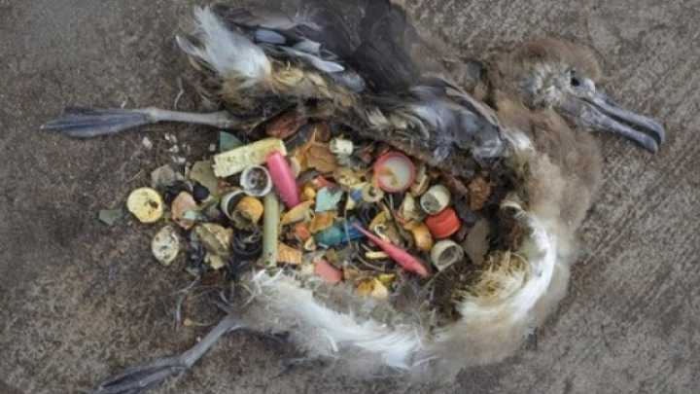
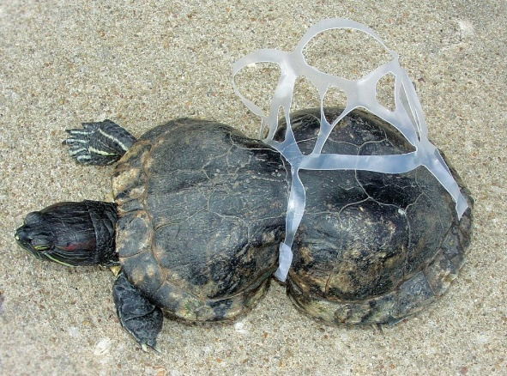
Or any of this…
“Scientists estimate that plastics kill up to 1 million seabirds and 100,000 marine mammals and sea turtles every year” (Myers & Spoolman, 2014, p. 307)
Fish found with stomachs full of plastic debris
Seabirds gulp down plastic fragments, then regurgitate and feed to their chicks
Chicks starve to death as plastics are indigestible (Cunningham & Cunningham, 2016, p. 475)

Slide 12
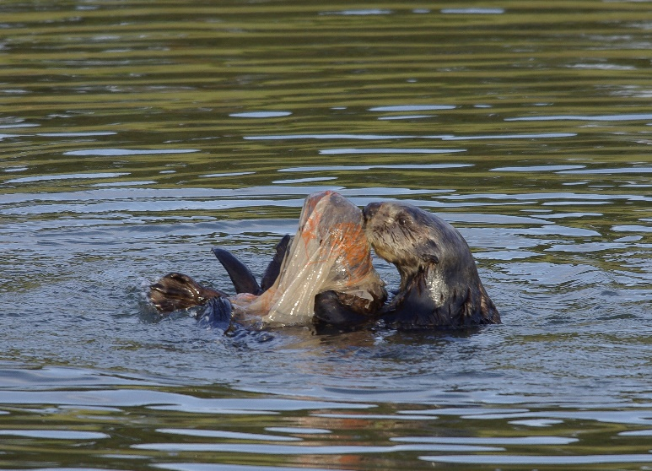
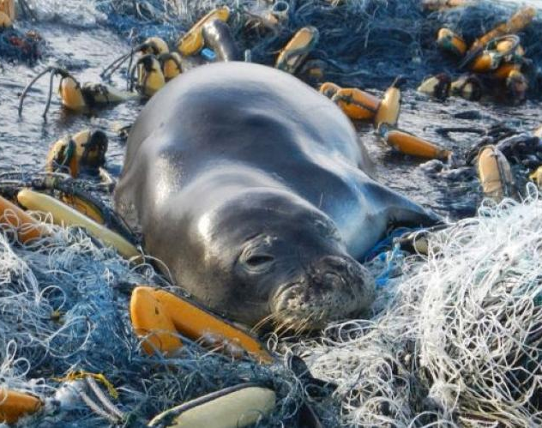
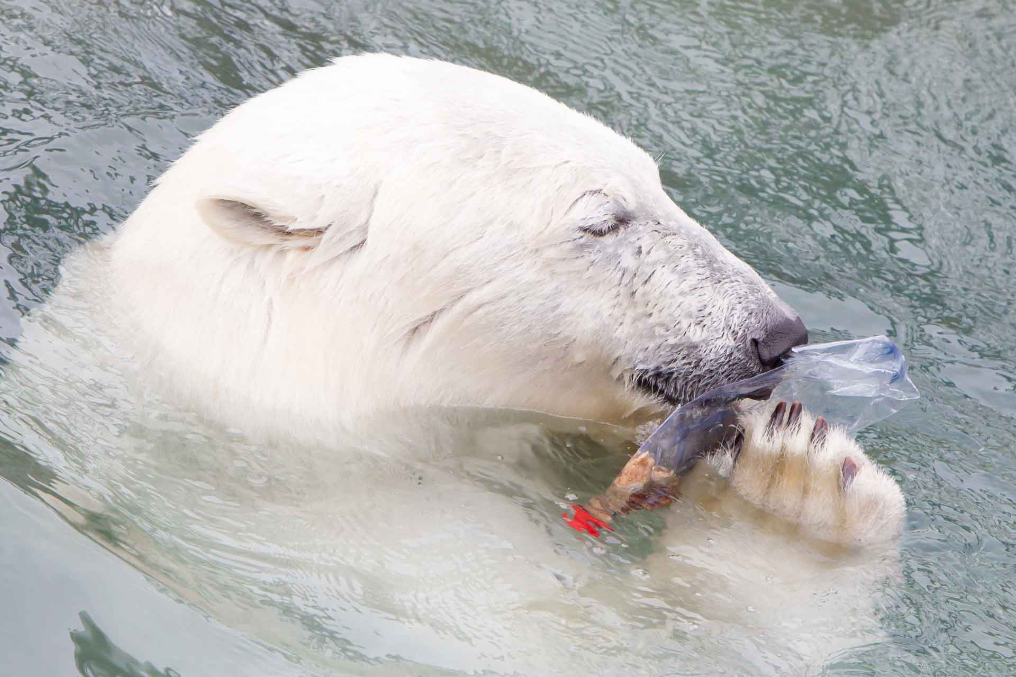
“Seals, turtles, porpoises, seabirds and other mammals become ensnared in ghost fishing nets and drown, or they die from ingesting indigestible materials” (Cunningham & Cunningham, 2016, p. 475)
Plastic shopping bags
Drink containers
Fast food boxes
K-cups
Bottle caps
Sources of waste:
Fall out of dumpsters
Tossed away on street
Wash away from landfills
Carried out to sea via storm sewers and streams

Slide 13
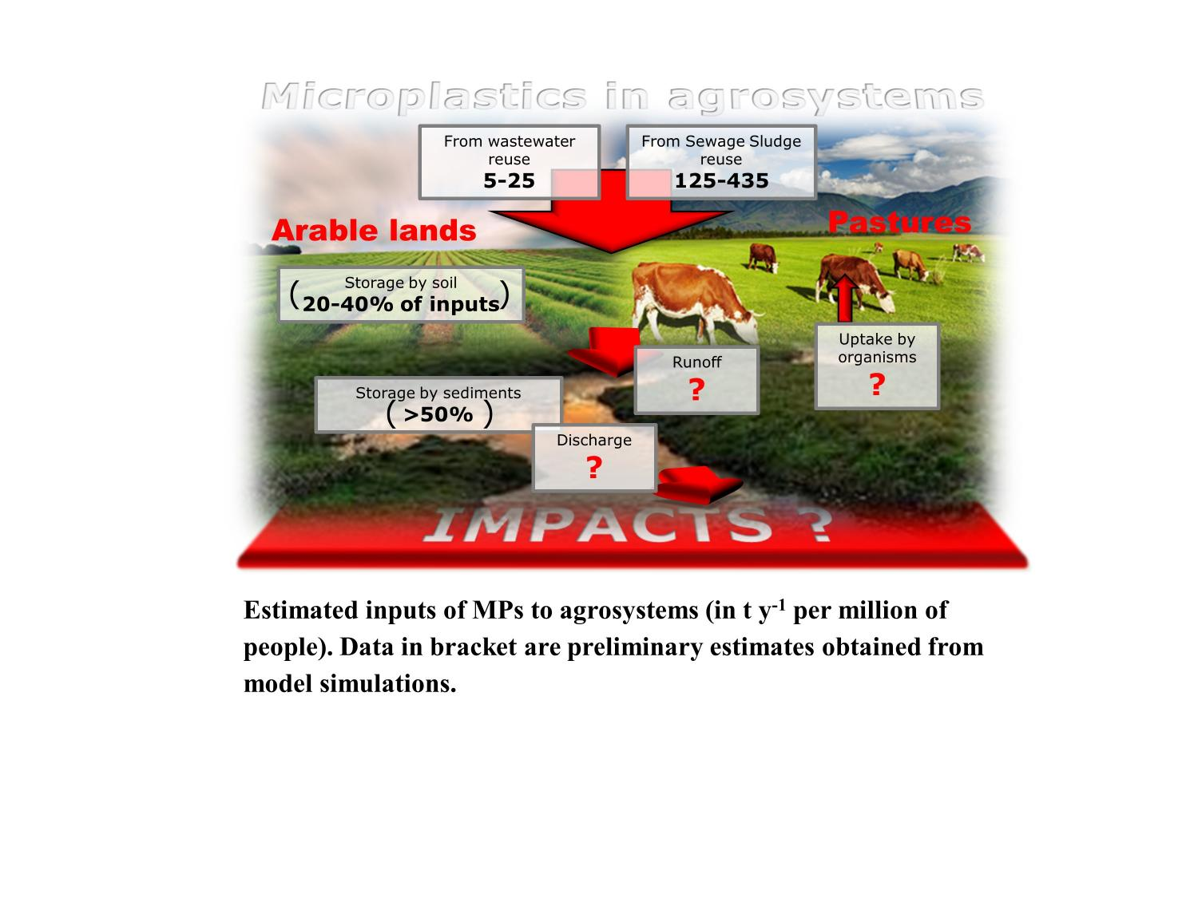
“Microplastics in soils have largely been overlooked” (Norwegian Institute for Water Research, 2016)
Primary focus has been on oceans
Sewage sludge from wastewater treatment plants made into fertilizer for agricultural use
Estimates of 110,000 – 730,000 tons annually used in agriculture
Potential consequences are unknown at this time

Slide 14
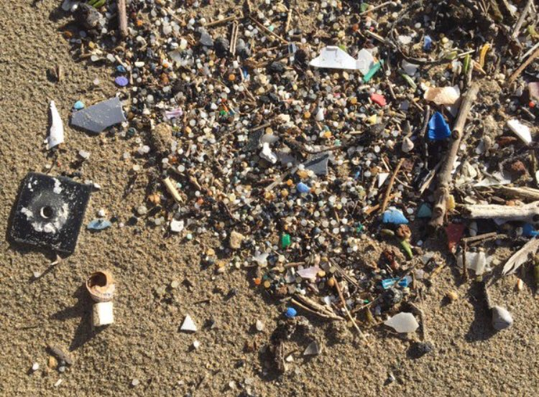
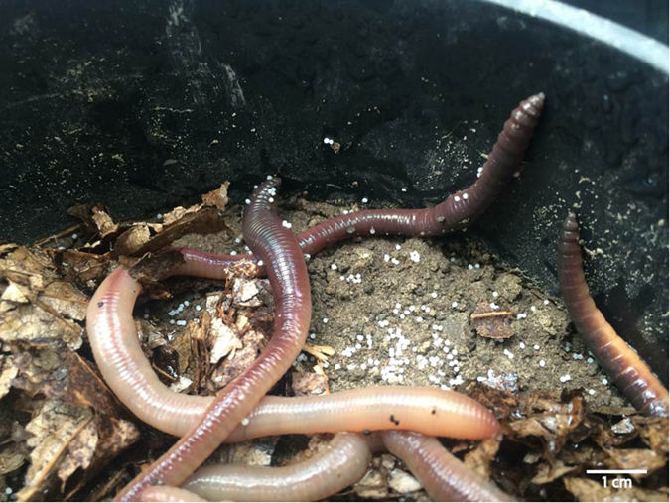
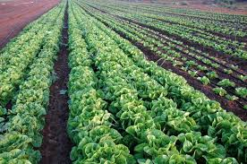
Image right: bits of polystyrene stuck to the bodies of earthworms
Will Mankind succumb to death by starvation due to the ingestion of indigestible materials from both our fish and seafood industry, as well as the vegetables, fruits and herbs we grow in this soil?

Slide 15

Waste removal companies, like Casella, now offer high-tech processing facilities to separate the different types of plastics and other recyclables (Casella, 2017).
Recycling is a start but…
…instead of Zero Sort, how about Zero Waste?

Slide 16
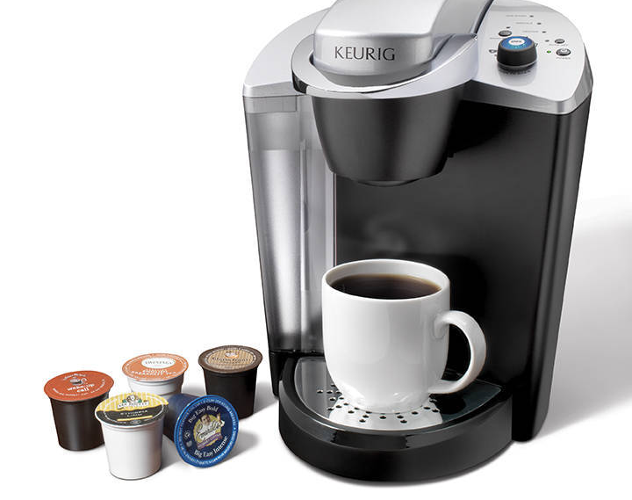

My pledge is to eliminate as much plastic as I can from my life…especially single-use items.
Keurig coffee makers have always been banned at The Herbal Hare Homestead
Mom sneaks in a roll of cellophane from time to time
I commute long distance for work and am guilty of fast food and/or take-out.

Slide 17
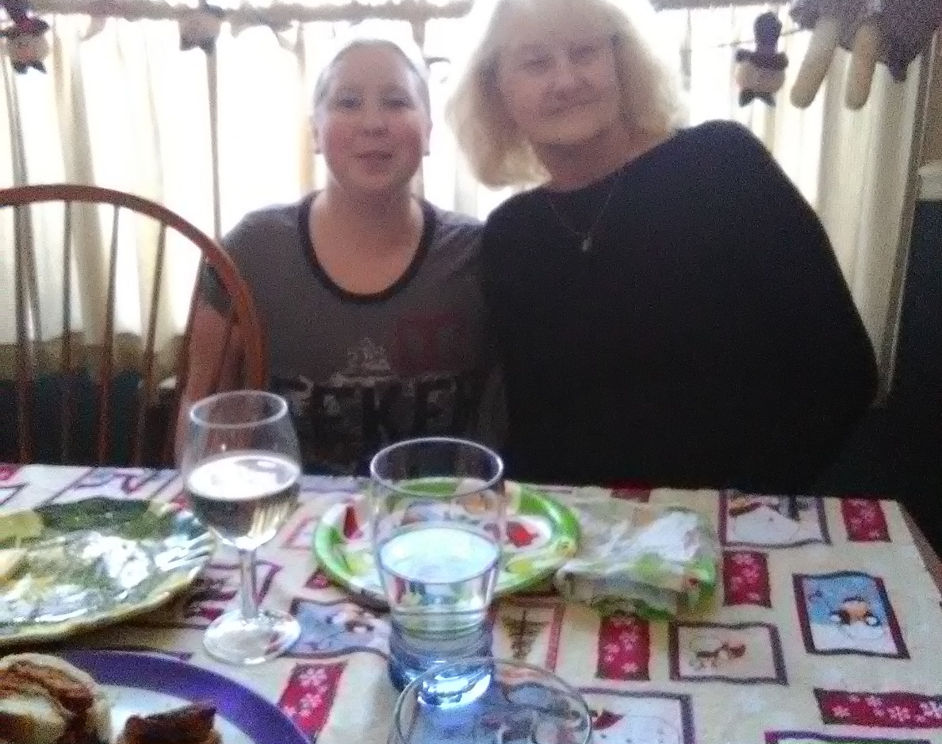
Step One: Host Family Meeting
If I just start making dramatic changes, nobody will understand the reason why; thoughts of depravity will ensue.
Education…not just about mitigating the harmful effects of plastic usage, but also offer some of the benefits of decreasing that use:
Decreased risk of cancer (Cunningham & Cunningham, 2015, p. 165)
Save money
Mom with Cousin Amanda at family birthday party

Slide 18

Step Two: better time management.
Packing a homemade lunch each night:
Keeps a lot of polystyrene and polyethylene out of the landfills, oceans and soils
Save money…money that could be saved towards some of the other high-dollar steps in this presentation.
An earlier start in the morning:
Time to brew an herbal tea for the ride in a reusable travel mug
No more sugar-based fake “Chai” at the local donut shop.

Slide 19
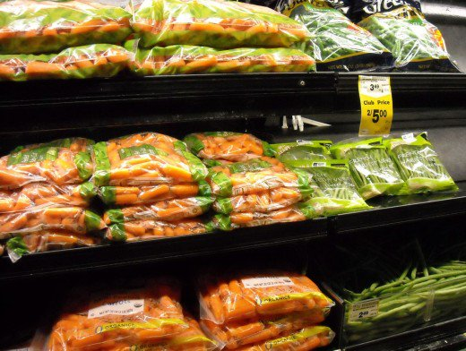
Step Three is to grow and raise as much food as my property can adequately…and humanely support.
Gardening:
Saves money.
Keeps more polyethylene and polystyrene out of the landfills.
Extend harvest for maximum waste reduction:
Starting seeds early in trays (or recycled, single-serve food containers)
Hardening off plants in cold frames
Composting
Successive planting methods

Slide 20
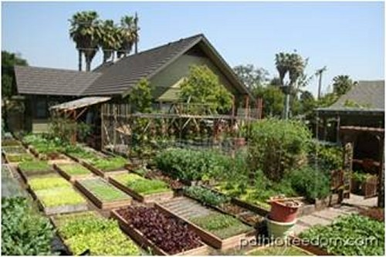
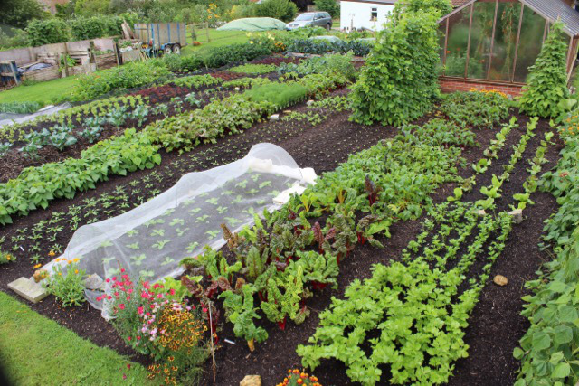
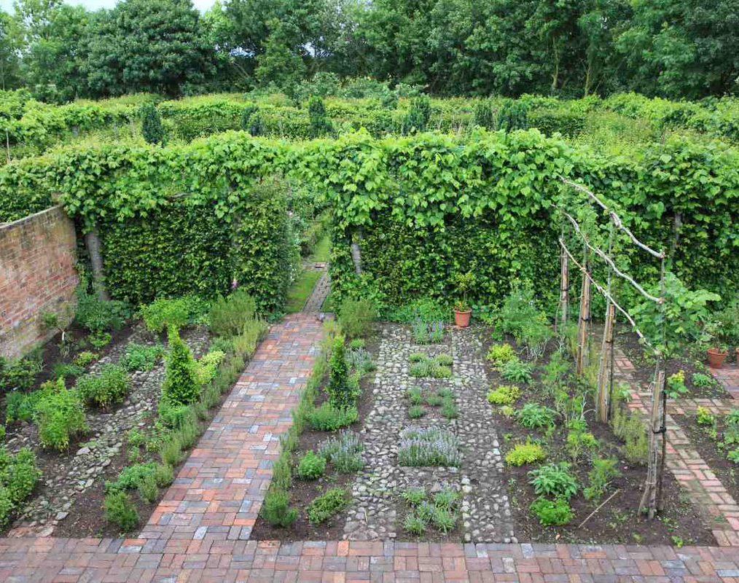
Some modern, and somewhat famous, gardens: (l to r) Path to Freedom (Dervaes’ family grows approx. 6000 lbs of fruits, veggies & herbs on 1/5 of an acre); Longmeadow (Monty Don of BBC’s Gardener’s World); Homeacres (Charles Dowding’s No-Dig YouTube channel)

Slide 21
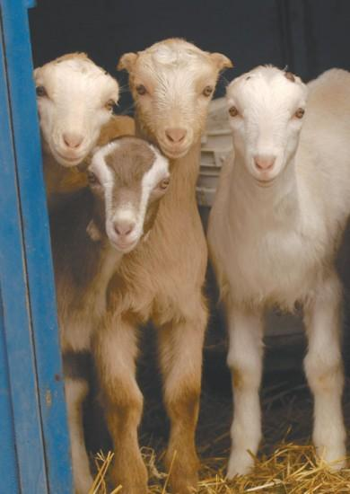
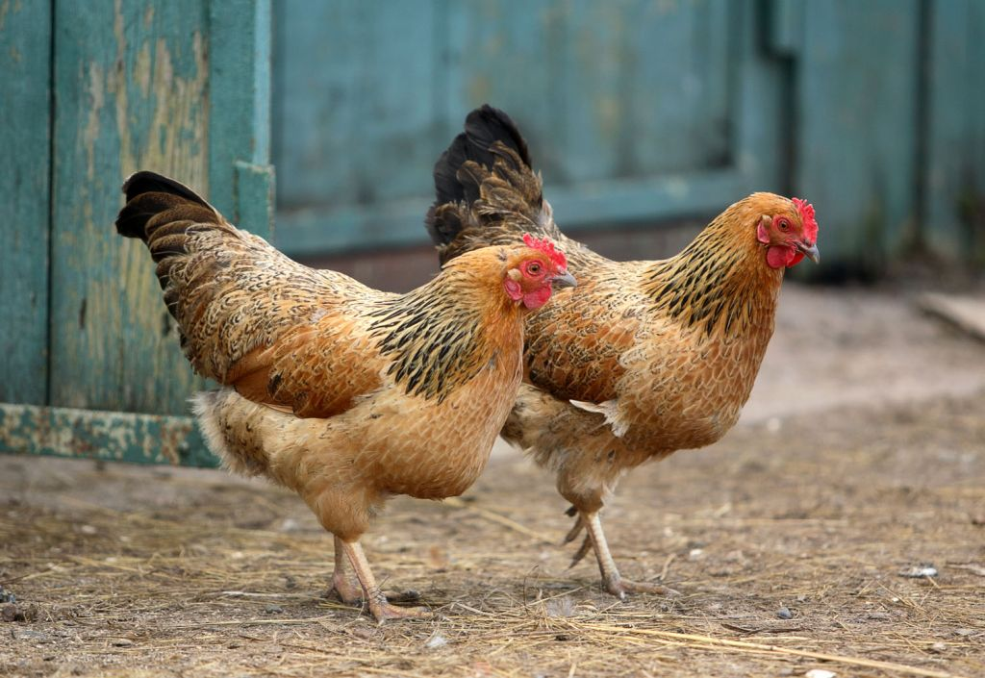
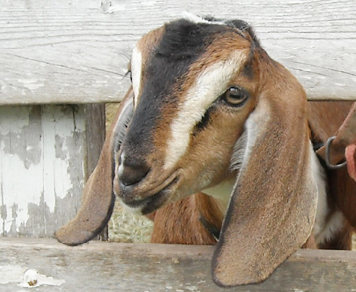
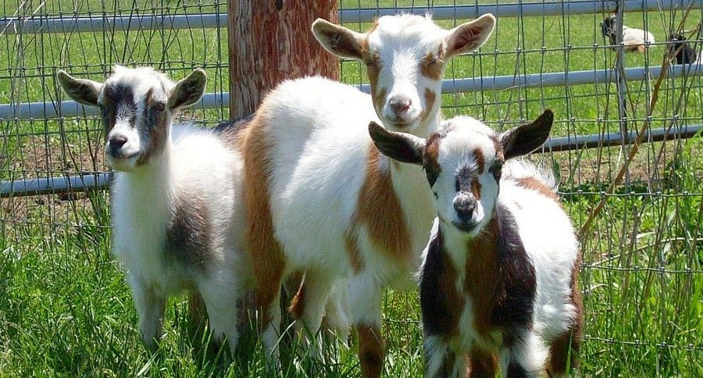
Raising small farm animals, like chickens and goats:
Reduces some polypropylene waste
Fewer chemicals
Free fertilizer reduces plastic waste from commercial soil amendment bags
Reduced need for sewer sludge = less microplastic in soil

Slide 22
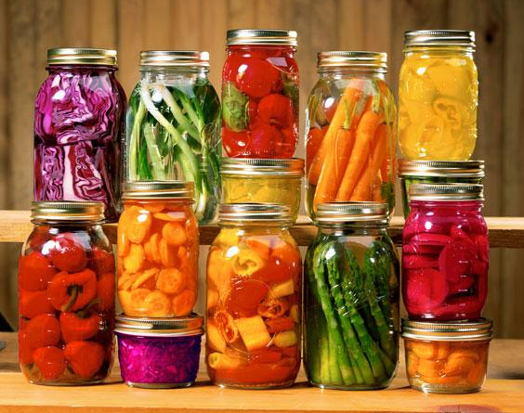
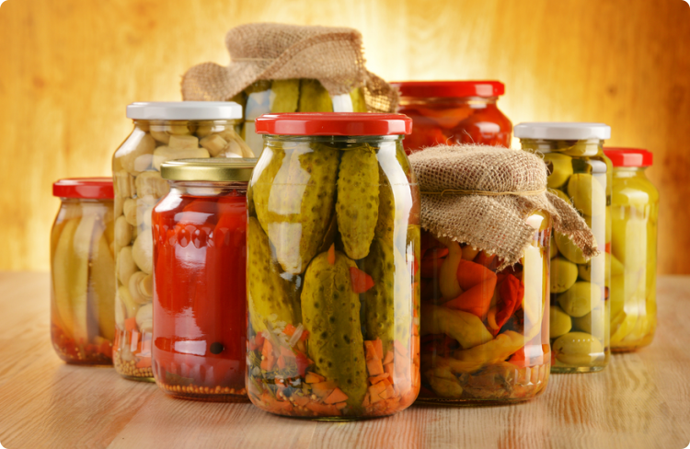
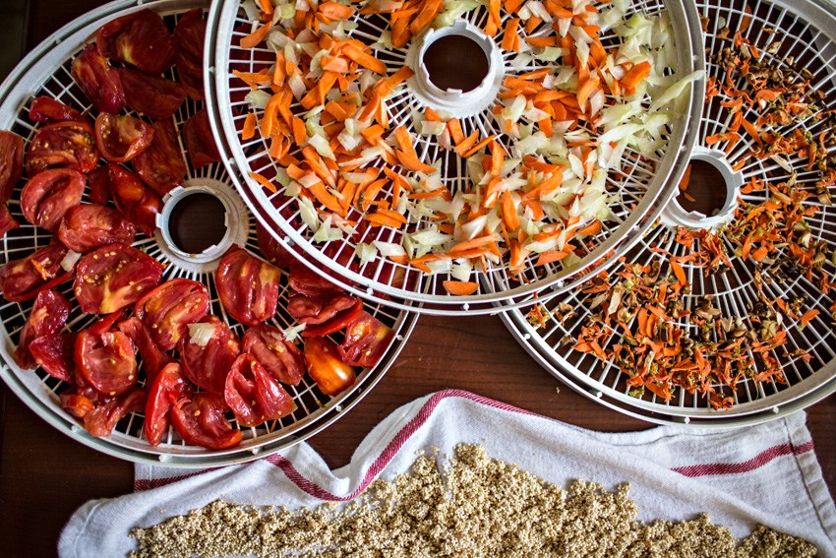
Not just growing and raising food but Step Four is preserving the harvest:
Canning
Drying
Fermenting
Preserves/jams/jellies
Pickling
Chutneys and Relishes
Reusable glass canning jars
Reusable glass storage bowls
Zero freezer bags, cellophane or polystyrene containers

Slide 23
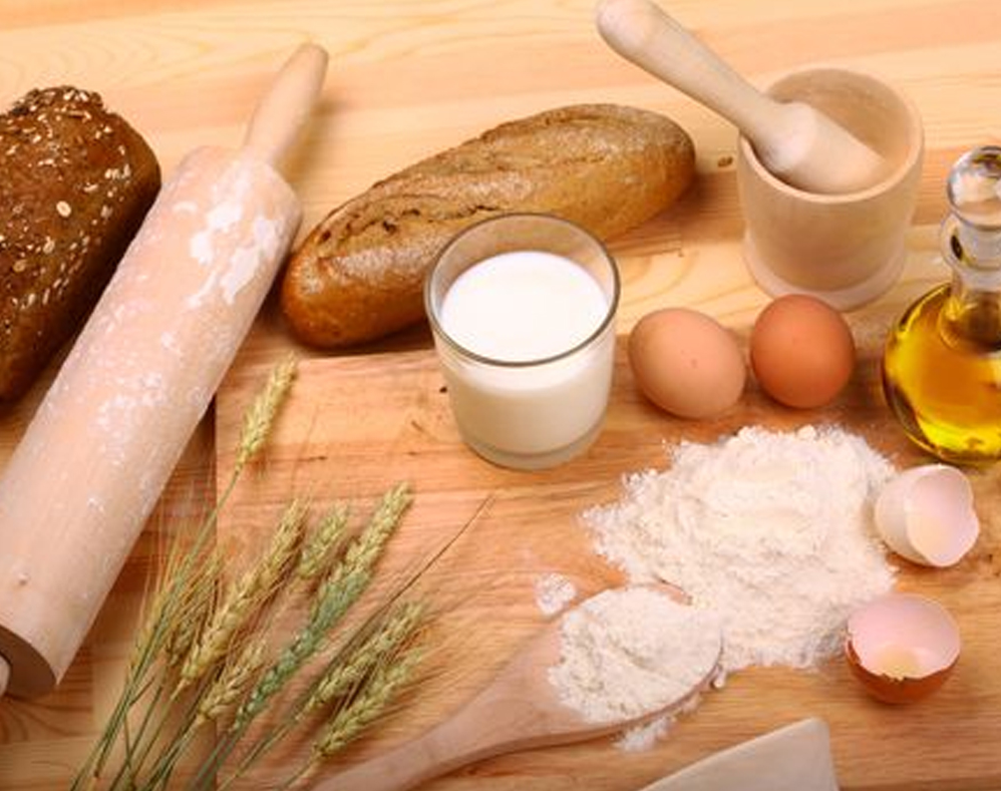
Step Five: Cook and bake from scratch
Buying ingredients like flour, sugar, baking soda and oil in bulk, and cooking/baking as much as possible from scratch:
Saves money
Reduces packaging waste
Tastes better
Healthier
Restores peace of mind (i.e. you know what’s in your food)

Slide 24


Step Six: Eliminate Plastic Water Bottles
Replace faulty salt-based water softener with a salt-free system
Replace the modern faucet with its perpetually warping washers (plastic/rubber waste) with a vintage hand pump; you use only the water you actually need with fewer leaks (this also saves energy and water, too)

Slide 25


Step Seven: making much of my own fabrics and clothing.
Plastic waste not confined solely to food packaging
Keeps plastic microfiber waste out of our water and soil
Saves money
Promotes creativity and design
Spinning & weaving part of my job at Old Sturbridge Village

Slide 26






Natural fibers come from:
Soay sheep
Jacobs sheep (Multi-horned ones)
Shetlands sheep
Angora goats (mohair)
Cashmere goats
Angora rabbits
Animals receive haircuts; no harm done; fiber grows back in a few months
Small breeds require minimal acreage

Slide 27

Step Eight: Zero-Waste Grocery Store, Bakery and Cafe
Reduces all manner of plastic food waste
Shows food producers how important plastic waste reduction is by sales/popularity
Influences government policy via purchasing habits
Add jobs to area
Educates public
Provides gathering place for community

Slide 28
REFERENCES
“6 Tips You Need to Know Before You Get Acrylic Nails.” xoJane. Image. Retrieved December 12, 2017 from: https://www.google.com/search?q=acrylics,+images&rlz=1C1OPRA_enUS563US627&tbm=isch&tbo=u&source=univ&sa=X&ved=0ahUKEwjSos_Q5IXYAhUHMyYKHcBsB2wQsAQIJg&biw=1366&bih=613#imgrc=7eeDIsdwRsXucM:
“21 Excellent Health Benefits of Fermented Foods.” Dr. Health Benefits. Image. Retrieved December 13, 2017 from: https://www.google.com/search?q=fermented+foods,+images&rlz=1C1OPRA_enUS563US627&tbm=isch&tbo=u&source=univ&sa=X&ved=0ahUKEwightT4qojYAhUIYiYKHdgfDLAQsAQIJg&biw=1366&bih=613#imgrc=x7pLdLsAEfMnPM:
“Acrylic Paint.” The Opus Online Store. Image. Retrieved December 12, 2017 from: https://www.google.com/search?q=acrylics,+images&rlz=1C1OPRA_enUS563US627&tbm=isch&tbo=u&source=univ&sa=X&ved=0ahUKEwjSos_Q5IXYAhUHMyYKHcBsB2wQsAQIJg&biw=1366&bih=613#imgrc=MRbImG3Zb_L6pM:
Andrady, A. L. & Neal, M. A. (2009). “Applications and Societal Benefits of Plastics.” Philosophical Transactions: Biological Sciences, (1526), 1977. doi:10.1098/rstb.2008.0304.
“Angora Goat Shearing.” FarmFlock. Image. Retrieved December 14, 2017 from: https://www.google.com/search?q=Angora+goats,+image&rlz=1C1OPRA_enUS563US627&tbm=isch&tbo=u&source=univ&sa=X&ved=0ahUKEwid5eaHlIvYAhUCOSYKHaL7BXIQsAQIJg&biw=1366&bih=613#imgrc=DH2TEBGGRT7K1M:
“Bottled Water.” Deer Park Brand Spring Water. Image. Retrieved December 12, 2017 from: https://www.google.com/search?q=deer+park,+bottled+water,+image&rlz=1C1OPRA_enUS563US627&tbm=isch&tbo=u&source=univ&sa=X&ved=0ahUKEwimr9zO3IXYAhVBOCYKHaPEBYcQsAQISg&biw=1366&bih=613#imgrc=Nqnr-GaPduPMPM:

Slide 29
Brand, S. (2012). “Life before Plastic.” Boing Boing. Retrieved November 12, 2017 from: https://boingboing.net/2012/05/25/life-before-plastic.html.
“Breeds of Livestock: Soay Sheep.” OSU Animal Science, Oklahoma State University. Image. Retrieved December 14, 2017 from: https://www.google.com/search?q=Soay+sheep,+image&rlz=1C1OPRA_enUS563US627&tbm=isch&tbo=u&source=univ&sa=X&ved=0ahUKEwiu1-fAlYvYAhXI5CYKHRUZA0UQsAQIJg&biw=1366&bih=613#imgrc=20IYkqVPsVjWxM:
Brodhagen, M., Goldberger, J. R., Hayes, D. G., Inglis, D. A., Marsh, T. L. & Miles, C. (2017). “Policy Considerations for Limiting Unintended Residual Plastic in Agricultural Soils.” Environmental Science and Policy, 81. doi:10.1016/j.envsci.2016.12.014
“Canning 101.” Pinterest. Image. Retrieved December 13, 2017 from: https://www.google.com/search?q=Canning,+images&rlz=1C1OPRA_enUS563US627&tbm=isch&tbo=u&source=univ&sa=X&ved=0ahUKEwjL0f7xqYjYAhWM7iYKHVzZAU0QsAQIJg&biw=1366&bih=613#imgrc=uIY7GQ3TlCgbZM:
Casella (2017). “How the Zero-Sort Machine Works.” Zero-Sort: How Recycling Gets Done, a Casella service. Retrieved November 19, 2017 from: www.casella.com
“Cashmere Goats.” The Goat Guide. Image. Retrieved December 14, 2017 from: https://www.google.com/search?q=cashmere+goats,+image&rlz=1C1OPRA_enUS563US627&tbm=isch&tbo=u&source=univ&sa=X&ved=0ahUKEwi5zqualYvYAhVCTCYKHVi7AOUQsAQIJg&biw=1366&bih=613#imgrc=wctXk3SugRRi4M:

Slide 30
“Charles Dowding’s No-Dig Gardening/Living with the Land.” YouTube. Image. Retrieved December 13, 2017 from: https://www.google.com/search?q=no+dig+gardening,+images&tbm=isch&tbs=rimg:CYfFufIdCzJ2IjjcZR3RoK6djdSio9fi0I6XmZZQFKWMdkJF05FgMhstM6-gQ7DT5OA9zWja1qTu6S19eYylLbhGGioSCdxlHdGgrp2NEbXFWPfMcEBxKhIJ1KKj1-LQjpcR-4nekj192NYqEgmZllAUpYx2QhFYeYD7kxYKyCoSCUXTkWAyGy0zEXzVzmUP3nmeKhIJr6BDsNPk4D0RRheyGe2uQhwqEgnNaNrWpO7pLRFQz-6v3_19b0SoSCX15jKUtuEYaEfevnxMM1GaQ&tbo=u&sa=X&ved=0ahUKEwi_oPSAnYjYAhVG1CYKHYrTDEMQ9C8IHw&biw=1366&bih=662&dpr=1#imgrc=h8W58h0LMnYQSM:
“Charles Goodyear – Inventor: Biography.” A & E’s Biography. Image. Retrieved December 12, 2017 from: https://www.google.com/search?q=goodyear+vulcanized+rubber,+image&rlz=1C1OPRA_enUS563US627&tbm=isch&tbo=u&source=univ&sa=X&ved=0ahUKEwjNi-e114XYAhVBRyYKHQ4YCyYQsAQIJg&biw=1366&bih=613#imgrc=HCETJf4xatia7M:
“Chickens – How to Keep Bugs at Bay.” Pets4Homes. Image. Retrieved December 14, 2017 from: https://www.google.com/search?q=chickens,+image&rlz=1C1OPRA_enUS563US627&tbm=isch&tbo=u&source=univ&sa=X&ved=0ahUKEwjI8u7GkYvYAhXE6CYKHcoqCLYQsAQIJg&biw=1366&bih=613#imgrc=G6XzXShbNw72rM:
“Chlorine.” Calismabarisi.com. Image. Retrieved December 12, 2017 from: https://www.google.com/search?q=Chlorine,+images&rlz=1C1OPRA_enUS563US627&tbm=isch&tbo=u&source=univ&sa=X&ved=0ahUKEwjz5PGU4YXYAhUBNiYKHaQbD5IQsAQIJg&biw=1366&bih=613#imgdii=YNFaV2yWf9AowM:&imgrc=VFNKYvybDIrvIM:

Slide 31
Cunningham, W. & Cunningham, M. A. (2015). Environmental Science: A Global Concern, thirteenth edition. New York: McGraw-Hill Education.
“Dehydrated Food Can Boost Your Health.” Tryingfitness.com. Image. Retrieved December 13, 2017 from: https://www.google.com/search?q=dehydrating+food,+image&rlz=1C1OPRA_enUS563US627&tbm=isch&tbo=u&source=univ&sa=X&ved=0ahUKEwjLwbGqqojYAhWG2yYKHclnBiIQsAQIJg&biw=1366&bih=613#imgdii=D0uoVSMcZujj6M:&imgrc=y5WAmI3V9ZUyTM:
“Discoveries of Polystyrene.” Polystyrene, by Zagros. Image. Retrieved December 12, 2017 from: https://www.google.com/search?q=eduard+simon,+poly+styrene&rlz=1C1OPRA_enUS563US627&tbm=isch&tbo=u&source=univ&sa=X&ved=0ahUKEwjCuc-f2oXYAhWKSyYKHd5zACkQsAQILw&biw=1366&bih=613#imgrc=w6KhT5AGrU1epM:
“Dow Chemical Company Logo.” Dragonfly Capital. Image. Retrieved December 14, 2017 from: https://www.google.com/search?q=dow+chemical+company,+logo&rlz=1C1OPRA_enUS563US627&tbm=isch&tbo=u&source=univ&sa=X&ved=0ahUKEwjh2oS5_YrYAhWJJiYKHSKKDZYQsAQIJg&biw=1366&bih=613#imgrc=oKQUF2MJmZNPKM:
“Enchanted Angora Rabbits.” Enchantedangorarabbits.weebly.com. Image. Retrieved December 14, 2017 from: https://www.google.com/search?q=angora+rabbit,+image&rlz=1C1OPRA_enUS563US627&tbm=isch&tbo=u&source=univ&sa=X&ved=0ahUKEwimwprJlovYAhXISyYKHb4zDjEQsAQIJg&biw=1366&bih=613#imgrc=-P6MOQTjdBkFPM:
“Eugene Baumann.” Wikipedia. Image: Retrieved December 12, 2017 from: https://www.google.com/search?q=eugene+baumann,+pvc,+image&rlz=1C1OPRA_enUS563US627&tbm=isch&tbo=u&source=univ&sa=X&ved=0ahUKEwjg297B3YXYAhXFNSYKHYDBDzkQsAQIKQ&biw=1366&bih=613#imgrc=zeI4XKhbIQp97M:

Slide 32
“Evian, 500ml.” Alibaba. Image. Retrieved December 21, 2017 from: https://www.google.com/search?q=evian+water+bottle,+image&rlz=1C1OPRA_enUS563US627&tbm=isch&tbo=u&source=univ&sa=X&ved=0ahUKEwjcpsbSsJvYAhVKMyYKHdeeBVwQsAQIRg&biw=1366&bih=662#imgrc=4MAenXZYmQoQDM:
“Exterior Window Shutters on a House.” Feldco. Image. Retrieved December 12, 2017 from: https://www.google.com/search?q=window+shutters,+images&rlz=1C1OPRA_enUS563US627&tbm=isch&tbo=u&source=univ&sa=X&ved=0ahUKEwiFjtfa1oXYAhVHSCYKHSkIBiYQsAQIzgE&biw=1366&bih=613#imgrc=yZ9B2pIfr4y01M:
“Family History Helpers.” Twitter. Image. Retrieved December 14, 2017 from: https://www.google.com/search?q=calico+printers+association,+letterhead+images&rlz=1C1OPRA_enUS563US627&tbm=isch&tbo=u&source=univ&sa=X&ved=0ahUKEwjekvnO7YrYAhXDQSYKHW7xDTsQsAQIJg&biw=1366&bih=662#imgrc=KUKUzl-TOB_bAM:
“Food and Bakery.” Al Maktab Al Qatari Al Hollandi WLL. Image. Retrieved December 24, 2017 from: https://www.google.com/search?q=bread+baking,+images&rlz=1C1OPRA_enUS563US627&tbm=isch&tbo=u&source=univ&sa=X&ved=0ahUKEwjkop2voKPYAhXKMSYKHceUArIQsAQIJg&biw=1366&bih=613#imgrc=O3SBYRxsl8AwuM:
“Great Pacific Garbage Patch – Ocean Pollution Awareness.” YouTube. Image. Retrieved December 12, 2017 from: https://www.google.com/search?q=great+pacific+garbage+patch,+images&rlz=1C1OPRA_enUS563US627&tbm=isch&tbo=u&source=univ&sa=X&ved=0ahUKEwjtxt3n6IXYAhXC5yYKHRBbChMQsAQIJg&biw=1366&bih=613#imgrc=Z2ouZNi_N3inyM:

Slide 33
“Guilio Natta Nobel Laureate Pioneer in Polymers.” World of Chemicals. Image. Retrieved December 12, 2017 from: https://www.google.com/search?q=giulio+natta+polypropylene,+image&rlz=1C1OPRA_enUS563US627&tbm=isch&tbo=u&source=univ&sa=X&ved=0ahUKEwiNjq_X54XYAhUG5SYKHf4JDLIQsAQIKQ&biw=1366&bih=613#imgrc=QI71a4Uug-yyJM:
Hafferty, S. (2017). “No Dig Gardening.” Image. Retrieved December 13, 2017 from: https://stephaniehafferty.co.uk/no-dig-gardening/
“Hana Bidon Polyethylene Terephthalate.” Venngage. Image. Retrieved December 12, 2017 from: https://www.google.com/search?q=polyethylene+terephthalate,+images&rlz=1C1OPRA_enUS563US627&tbm=isch&tbo=u&source=univ&sa=X&ved=0ahUKEwjayYmV44XYAhWH4SYKHYMsAroQsAQIKw&biw=1366&bih=613#imgrc=lkUe_Y-xbpFomM:
“Hawaii Just Banned Plastic Bags at Grocery Checkouts.” CSGlobe. Image. Retrieved December 12, 2017 from: https://www.google.com/search?q=plastic+shopping+bags+in+ocean,+image&rlz=1C1OPRA_enUS563US627&tbm=isch&tbo=u&source=univ&sa=X&ved=0ahUKEwikve276oXYAhWDQSYKHb2cC0EQsAQIJg&biw=1366&bih=613#imgrc=iuRM1hiio-J8cM:
“Historia dos Polimeros timeline, Reginald Gibson and Eric Fawcett”. Timetoast.com. Image. Retrieved December 12, 2017 from: https://www.google.com/search?q=eric+fawcett+and+reginald+gibson,+images&rlz=1C1OPRA_enUS563US627&tbm=isch&tbo=u&source=univ&sa=X&ved=0ahUKEwjjkJbx3YXYAhUMOyYKHZX7DfQQsAQIJg&biw=1366&bih=613#imgdii=B7YTNc_X8mYoMM:&imgrc=8NpR9slAT88moM:

Slide 34
“Is a Zero Waste Grocery Store Possible?” Mother Nature Network. Image. Retrieved December 20, 2017 from: https://www.google.com/search?q=zero+Waste+grocery+store,+image&rlz=1C1OPRA_enUS563US627&tbm=isch&tbo=u&source=univ&sa=X&ved=0ahUKEwjOivXAgJrYAhWKdSYKHVuHBkgQsAQIJg&biw=1366&bih=662#imgrc=WR8ICbWc6K0NJM:
“Jacob Sheep.” Ledyard Farms. Image. Retrieved December 14, 2017 from: https://www.google.com/search?q=Jacobs%27+sheep,+image&rlz=1C1OPRA_enUS563US627&tbm=isch&tbo=u&source=univ&sa=X&ved=0ahUKEwiNoq7zlYvYAhXCZCYKHZt0DAAQsAQIJg&biw=1366&bih=613#imgrc=gVvu3iD-2M-WtM:
“Keurig OfficePRO K145 Single-Cup.” Staples. Image. Retrieved December 14, 2017 from: https://www.google.com/search?q=keurig+machine,+image&rlz=1C1OPRA_enUS563US627&tbm=isch&tbo=u&source=univ&sa=X&ved=0ahUKEwj734Kxh4vYAhWI6CYKHaMnCXEQsAQIlAI&biw=1366&bih=613#imgrc=OUe1UmfHoodIVM:
“Kitchen Water Pump of Boston Hotel.” Kitchen. Image. Retrieved December 24, 2017 from: https://www.google.com/search?q=sink+with+hand+pump,+image&rlz=1C1OPRA_enUS563US627&tbm=isch&tbo=u&source=univ&sa=X&ved=0ahUKEwiM6Ivao6PYAhXDQCYKHY6rBI0QsAQIfg&biw=1366&bih=613#imgrc=Uxk_JDr1K-d8LM:
Lapham, S. S. (2009). “Bottled or Tap?: A Controversy for Science, Economics, and Society.” Social Education, (5), 236.
“Let’s Talk About PVC.” Dienamics. Image. Retrieved December 12, 2017 from: https://www.google.com/search?q=PVC+images&rlz=1C1OPRA_enUS563US627&tbm=isch&tbo=u&source=univ&sa=X&ved=0ahUKEwjzhO3R34XYAhVEwiYKHdNVCIMQsAQIJg&biw=1366&bih=613#imgrc=RG7CFgqzuC815M:

Slide 35
“Low Density Polyethylene.” Tosoh Corporation. Image. Retrieved December 12, 2017 from: https://www.google.com/search?q=polyethylene+plastic+agricultural+films,+images&rlz=1C1OPRA_enUS563US627&tbm=isch&tbo=u&source=univ&sa=X&ved=0ahUKEwizwLub6IXYAhVL8CYKHfwQDpQQsAQIJg&biw=1366&bih=613#imgrc=0XTA2bcADo-pIM:
“Man Fired for Using Potato Chip Bag to Skip Work for Two Years.” Los Angeles Times. Image. Retrieved December 12, 2017 from: https://www.google.com/search?q=potato+chip+bag,+image&rlz=1C1OPRA_enUS563US627&tbm=isch&tbo=u&source=univ&sa=X&ved=0ahUKEwjbnNCQ5oXYAhXBKCYKHSzYC1AQsAQIQg&biw=1366&bih=613#imgrc=S01xup70yZ9snM:
“Microbeads Banned! A Victory over Ocean Plastic Pollution.” Conservation & Science –Wordpress.com. Image. Retrieved December 12, 2017 from: https://www.google.com/search?q=plastic+shopping+bags+in+ocean,+image&rlz=1C1OPRA_enUS563US627&tbm=isch&tbo=u&source=univ&sa=X&ved=0ahUKEwikve276oXYAhWDQSYKHb2cC0EQsAQIJg&biw=1366&bih=613#imgrc=I3sXJiRJbRZ8AM:
“Microplastic Transport in Soil by Earthworms.” Nature. Image. Retrieved December 24, 2017 from: https://www.google.com/search?q=microplastics+in+the+soil,+image&rlz=1C1OPRA_enUS563US627&tbm=isch&tbo=u&source=univ&sa=X&ved=0ahUKEwij3b26-aLYAhXEKCYKHe50B4QQsAQIJg&biw=1366&bih=662#imgrc=htVVBHvJO0WSXM:
“Microplastics.” Twitter. Image. Retrieved December 24, 2017 from: https://www.google.com/search?q=microplastics+in+the+soil,+image&rlz=1C1OPRA_enUS563US627&tbm=isch&tbo=u&source=univ&sa=X&ved=0ahUKEwjR-ubSi6PYAhVHYiYKHdXjDYoQsAQIJg&biw=1366&bih=613#imgrc=hMPb_CVuzoi12M:

Slide 36
“Microplastics in Agricultural Soils: A Reason to Worry.” Mynewsdesk. Image. Retrieved December 24, 2017 from: https://www.google.com/search?q=microplastics+in+the+soil,+image&rlz=1C1OPRA_enUS563US627&tbm=isch&tbo=u&source=univ&sa=X&ved=0ahUKEwjR-ubSi6PYAhVHYiYKHdXjDYoQsAQIJg&biw=1366&bih=613#imgrc=8lstt23oVRzmGM:
“Monty Don on Twitter: Ch Ch Changes.” Twitter. Image. Retrieved December 13, 2017 from: https://www.google.com/search?q=monty+don+longmeadow,+images&rlz=1C1OPRA_enUS563US627&tbm=isch&tbo=u&source=univ&sa=X&ved=0ahUKEwiszZOOgaPYAhUFMyYKHfB8AcsQsAQIJg&biw=1366&bih=613#imgrc=6JBRJVklKiHLsM:
Myers, N. & Spoolman, S. E. (2014). Environmental Issues and Solutions: A Modular Approach. California: Cengage Learning.
“Nigerian Dwarf Goats.” Wide Open Pets. Image. Retrieved December 14, 2017 from: https://www.google.com/search?q=nigerian+dwarf+goats,+image&rlz=1C1OPRA_enUS563US627&tbm=isch&tbo=u&source=univ&sa=X&ved=0ahUKEwiplpXZk4vYAhXFZCYKHYFDClMQsAQIJg&biw=1366&bih=613#imgrc=wSi-yuBf135JwM:
“No Dig Gardening Beds.” Permaculture Visions. Retrieved December 13, 2017 from: https://www.google.com/search?q=no+dig+gardening,+images&tbm=isch&tbs=rimg:CYfFufIdCzJ2IjjcZR3RoK6djdSio9fi0I6XmZZQFKWMdkJF05FgMhstM6-gQ7DT5OA9zWja1qTu6S19eYylLbhGGioSCdxlHdGgrp2NEbXFWPfMcEBxKhIJ1KKj1-LQjpcR-4nekj192NYqEgmZllAUpYx2QhFYeYD7kxYKyCoSCUXTkWAyGy0zEXzVzmUP3nmeKhIJr6BDsNPk4D0RRheyGe2uQhwqEgnNaNrWpO7pLRFQz-6v3_19b0SoSCX15jKUtuEYaEfevnxMM1GaQ&tbo=u&sa=X&ved=0ahUKEwi_oPSAnYjYAhVG1CYKHYrTDEMQ9C8IHw&biw=1366&bih=662&dpr=1#imgrc=BXtZRZuJ2W4f2M:

Slide 37
“No Dig Gardening – Create New Beds.” GrowVeg.com. Image. Retrieved December 13, 2017 from: https://www.google.com/search?q=no+dig+gardening,+images&tbm=isch&tbs=rimg:CYfFufIdCzJ2IjjcZR3RoK6djdSio9fi0I6XmZZQFKWMdkJF05FgMhstM6-gQ7DT5OA9zWja1qTu6S19eYylLbhGGioSCdxlHdGgrp2NEbXFWPfMcEBxKhIJ1KKj1-LQjpcR-4nekj192NYqEgmZllAUpYx2QhFYeYD7kxYKyCoSCUXTkWAyGy0zEXzVzmUP3nmeKhIJr6BDsNPk4D0RRheyGe2uQhwqEgnNaNrWpO7pLRFQz-6v3_19b0SoSCX15jKUtuEYaEfevnxMM1GaQ&tbo=u&sa=X&ved=0ahUKEwi_oPSAnYjYAhVG1CYKHYrTDEMQ9C8IHw&biw=1366&bih=662&dpr=1#imgrc=XTPRNGFT4IsM3M:
Norwegian Institute for Water Research (2016). “Microplastics in Agricultural Soils.” Image. Retrieved from: https://phys.org/news/2016-10-microplastics-agricultural-soilsa.html
Norwegian Institute for Water Research (2016). “Microplastics in Agricultural Soils – A Reason to Worry?” Phys.org. Retrieved from: https://phys.org/news/2016-10-microplastics-agricultural-soilsa.html
“Oceans Deeply Talks: Drowning in Plastic.” Newsdeeply.com. Image. Retrieved December 12, 2017 from: https://www.google.com/search?q=plastic+ocean+waste,+images&rlz=1C1OPRA_enUS563US627&tbm=isch&tbo=u&source=univ&sa=X&ved=0ahUKEwjN85-F7IXYAhXD4iYKHV86BAQQsAQIJg&biw=1366&bih=613#imgdii=oNGUMvwxi6VCdM:&imgrc=b5hpP4C1c_707M:
“Organic Teas Canada: Our Enticing Herb Blends.” Organic Teas Canada. Image. Retrieved December 24, 2017 from: https://www.google.com/search?q=cup+of+herb+tea,+image&rlz=1C1OPRA_enUS563US627&tbm=isch&tbo=u&source=univ&sa=X&ved=0ahUKEwjcyIKeq6PYAhUFySYKHeIEBb4QsAQITg&biw=1366&bih=613#imgrc=IXrcXzK5i-9FcM:

Slide 38
“Pantyhose Brings Back Memories.” Vintage Coconut. Image. Retrieved December 14, 2017 from: https://www.google.com/search?q=leggs+pantyhose,+image&rlz=1C1OPRA_enUS563US627&tbm=isch&tbo=u&source=univ&sa=X&ved=0ahUKEwipzdLc84rYAhXI7iYKHUkeADIQsAQIpAE&biw=1366&bih=613#imgrc=DLOSgghTAjqVWM:
“Path to Freedom – Homestead Growing.” VividLife.me. Image. Retrieved December 13, 2017 from: https://www.google.com/search?q=path+to+freedom,+images&rlz=1C1OPRA_enUS563US627&tbm=isch&tbo=u&source=univ&sa=X&ved=0ahUKEwiV69f0qIjYAhUMMSYKHbCuDYcQsAQIJg&biw=1366&bih=613#imgrc=T4af4GLFzWV-xM:
“Perrier.” Dragon Rouge. Image. Retrieved December 21, 2017 from: https://www.google.com/search?q=perrier,+imAGES&rlz=1C1OPRA_enUS563US627&tbm=isch&tbo=u&source=univ&sa=X&ved=0ahUKEwiTyL6eqpvYAhUPySYKHQ7VDbMQsAQIJg&biw=1366&bih=662#imgrc=tKfudKw0BhXx8M:
“Plastic Pollution.” Coastal Care. Image. Retrieved December 12, 2017 from: https://www.google.com/search?q=polyethylene,+sea+mammals,+images&rlz=1C1OPRA_enUS563US627&tbm=isch&tbo=u&source=univ&sa=X&ved=0ahUKEwjqj_Xg7YXYAhWD1CYKHbNYAlEQsAQIJg&biw=1366&bih=613#imgrc=6wUqhzB_ApXyaM:
“Plastic Pollution: Plastic is the Worst Material Ever Invented.” New Nourish. Image. Retrieved December 12, 2017 from: https://www.google.com/search?q=polyethylene,+sea+mammals,+images&rlz=1C1OPRA_enUS563US627&tbm=isch&tbo=u&source=univ&sa=X&ved=0ahUKEwjqj_Xg7YXYAhWD1CYKHbNYAlEQsAQIJg&biw=1366&bih=613#imgrc=wF5XKv43nfX1tM:

Slide 39
“Poland Dating Tours.” Poland Mineral Springs Water. Image. Retrieved December 12, 2017 from: https://www.google.com/search?q=poland+springs+1845,+image&rlz=1C1OPRA_enUS563US627&tbm=isch&tbo=u&source=univ&sa=X&ved=0ahUKEwiT1f_S1YXYAhUDbiYKHTYOACUQsAQIJg&biw=1366&bih=662#imgrc=f6T1slZgHhTDYM:
“Polystyrene Will Be Banned in the Federal Territories from Jan. 1, 2017.” Lipstiq.com. Retrieved December 12, 2017 from: https://www.google.com/search?q=polystyrene,+images&rlz=1C1OPRA_enUS563US627&tbm=isch&tbo=u&source=univ&sa=X&ved=0ahUKEwimlra84oXYAhWGeCYKHeS4DMYQsAQIJg&biw=1366&bih=613#imgrc=13jPO5IRywJAUM:
“Pre-Packaged Produce: Fresh Foods.” Delishably. Image. Retrieved December 14, 2017 from: https://www.google.com/search?q=cellophane+wrapped+produce,+image&rlz=1C1OPRA_enUS563US627&tbm=isch&tbo=u&source=univ&sa=X&ved=0ahUKEwiUxve5i4vYAhXDZCYKHSdQB1UQsAQIJg&biw=1366&bih=613#imgrc=Vvq7MmdSepHxCM:
“Salt-free Water Softener.” Aquasana. Image. Retrieved December 24, 2017 from: https://www.google.com/search?q=chemical+free+water+softener,+image&rlz=1C1OPRA_enUS563US627&tbm=isch&tbo=u&source=univ&sa=X&ved=0ahUKEwjx9deopqPYAhUFziYKHZTUAmUQsAQI_AE&biw=1366&bih=613#imgrc=KtLznaxCDB94EM:
“Samsung 59cm (24 inch) HD Ready.” Flipkart. Image. Retrieved December 12, 2017 from: https://www.google.com/search?q=TV+image&rlz=1C1OPRA_enUS563US627&tbm=isch&tbo=u&source=univ&sa=X&ved=0ahUKEwik1qbi4IXYAhUFyyYKHfZCAvoQsAQIJg&biw=1366&bih=613#imgrc=o4OsAXehMIRJpM:

Slide 40
“Saran (plastic).” Wikipedia. Image. Retrieved December 12, 2017 from: https://www.google.com/search?q=Cling+wrap,+images&rlz=1C1OPRA_enUS563US627&tbm=isch&tbo=u&source=univ&sa=X&ved=0ahUKEwjHt6qk4IXYAhWJQCYKHY9XDlMQsAQIJg&biw=1366&bih=613#imgrc=EQ0T7L9x3vZiZM:
“Saxony Spinning Wheels.” The Woolery. Image. Retrieved December 13, 2017 from: https://www.google.com/search?q=spinning+wheel+images&rlz=1C1OPRA_enUS563US627&tbm=isch&tbo=u&source=univ&sa=X&ved=0ahUKEwjNo5TIrIjYAhXC5SYKHRngB_UQsAQIJg&biw=1366&bih=613#imgrc=MxcJlhPnsXCZFM:
“Seabirds are Eating Plastic Litter in Oceans.” Iflscience.com. Image. Retrieved December 12, 2017 from: https://www.google.com/search?q=polyethylene,+sea+mammals,+images&rlz=1C1OPRA_enUS563US627&tbm=isch&tbo=u&source=univ&sa=X&ved=0ahUKEwjqj_Xg7YXYAhWD1CYKHbNYAlEQsAQIJg&biw=1366&bih=613#imgdii=hBN7qrII40mv-M:&imgrc=xTh3ehjfGjyxoM:
“Sheep.” Canadian Co-Operative Wool Growers Limited. Image. Retrieved December 14, 2017 from: https://www.google.com/search?q=Shetland+sheep,+image&rlz=1C1OPRA_enUS563US627&tbm=isch&tbo=u&source=univ&sa=X&ved=0ahUKEwie2MS5lIvYAhXEZiYKHV83D_gQsAQIJg&biw=1366&bih=613#imgrc=PerP1kDsZ5bURM:
“The Goats of Lamancha.” Billingsgazette.com. Image. Retrieved December 14, 2017 from: https://www.google.com/search?q=la+mancha+and+nubian+goats,+image&rlz=1C1OPRA_enUS563US627&tbm=isch&tbo=u&source=univ&sa=X&ved=0ahUKEwjuo-qvkovYAhVCMSYKHRE5CigQsAQIJg&biw=1366&bih=613#imgdii=orDWLQmuYm8eXM:&imgrc=756_QAJuAZ1SLM:

Slide 41
“The Great Pacific Garbage Patch.” Odyssey. Image of Turtle. Retrieved December 12, 2017 from: https://www.google.com/search?q=great+pacific+garbage+patch,+images&rlz=1C1OPRA_enUS563US627&tbm=isch&tbo=u&source=univ&sa=X&ved=0ahUKEwjtxt3n6IXYAhXC5yYKHRBbChMQsAQIJg&biw=1366&bih=613#imgrc=mxpA_LlYpYbGOM:
“Top O’ Hills Acres: Registered Nubian.” Top O’ Hills Acres. Image. Retrieved December 14, 2017 from: https://www.google.com/search?rlz=1C1OPRA_enUS563US627&biw=1366&bih=613&tbm=isch&sa=1&ei=rUozWoOXBMGamQHataH4Dw&q=nubian+goats%2C+image&oq=nubian+goats%2C+image&gs_l=psy-ab.12..0.149064.149966.0.151532.14.5.0.0.0.0.145.609.1j4.5.0....0...1c.1.64.psy-ab..12.1.143....0.EtPya4EwTIo#imgrc=zLiPs4f_sxR24M:
Town of Brooklyn, Connecticut (2012). “Single Bin Recycling.” Curbside Recycling. Retrieved November 19, 2017 from: www.brooklynct.org/home/pages
“Types of Looms.” Warp or Weft. Image. Retrieved December 13, 2017 from: https://www.google.com/search?q=loom,+images&rlz=1C1OPRA_enUS563US627&tbm=isch&tbo=u&source=univ&sa=X&ved=0ahUKEwiT-fuIrYjYAhXFPCYKHUc9AqcQsAQIJg&biw=1366&bih=613#imgrc=LVPUgOAgO_AjAM:
“Un Lieu sur Terre: Farms to Table/ Path to Freedom.” Un Lieu sur Terre. Image. Retrieved December 13, 2017 from: https://www.google.com/search?q=path+to+freedom,+images&rlz=1C1OPRA_enUS563US627&tbm=isch&tbo=u&source=univ&sa=X&ved=0ahUKEwiV69f0qIjYAhUMMSYKHbCuDYcQsAQIJg&biw=1366&bih=613#imgrc=7zsMF8mjSBVjmM:
U.S. Energy Information Administration (2017). Frequently Asked Questions: How Much Oil is Used to Make Plastic? Retrieved December 14, 2017 from: https://www.eia.gov/tools/faqs/faq.php?id=34&t=6

Slide 42
“What is Vulcanized Rubber?” wiseGEEK. Image. Retrieved December 12, 2017 from: https://www.google.com/search?q=vulcanized+rubber,+image&rlz=1C1OPRA_enUS563US627&tbm=isch&tbo=u&source=univ&sa=X&ved=0ahUKEwiWxt7Z3oXYAhXIVyYKHTX4BqoQsAQIJg&biw=1366&bih=613#imgrc=WUzO_aDyCcI_gM:
“Will Polyester Shrink?” Sew Guide. Image. Retrieved December 12, 2017 from: https://www.google.com/search?q=polyester+images&rlz=1C1OPRA_enUS563US627&tbm=isch&tbo=u&source=univ&sa=X&ved=0ahUKEwjR1--b5IXYAhXCSSYKHWokCyYQsAQIJg&biw=1366&bih=613#imgrc=gJA7pfrzpRbl0M:
Xanthos, D. & Walker, T. R. (2017). “International Policies to Reduce Plastic Marine Pollution from Single-Use Plastics (Plastic Bags and Microbeads): A Review.” Marine Pollution Bulletin, (1-2), 17. doi:10.1016/j.marpolbul.2017.02.048.
“Yoplait Yogurt Cups Have Been Killing Small Animals for Years.” Huffington Post. Image. Retrieved December 12, 2017 from: https://www.google.com/search?q=Yogurt+cups,+images&rlz=1C1OPRA_enUS563US627&tbm=isch&tbo=u&source=univ&sa=X&ved=0ahUKEwjQmpTR5YXYAhUFQSYKHZxCArsQsAQIJg&biw=1366&bih=613#imgrc=-PjOp1erPV9dqM:
“Zero Sort Recycling Makes Going Green Easier than Ever.” United Helpers. Image. Retrieved December 14, 2017 from: https://www.google.com/search?q=casella+zero+sort,+image&rlz=1C1OPRA_enUS563US627&tbm=isch&tbo=u&source=univ&sa=X&ved=0ahUKEwiJm8XihIvYAhWM7yYKHUoPBy0QsAQIJg&biw=1366&bih=613#imgrc=f7ORW2-wG-mbsM:
“Ziploc Freezer Bags Quart.” SC Johnson. Image. Retrieved December 12, 2017 from: https://www.google.com/search?q=freezer+bags+image&rlz=1C1OPRA_enUS563US627&tbm=isch&tbo=u&source=univ&sa=X&ved=0ahUKEwijgaXT4YXYAhWJWCYKHTWEB0YQsAQImgE&biw=1366&bih=613#imgrc=eWt2-x5bfB9s1M:

